Slide 1
Model formulation and prediction
Daman Virdi

Slide 2
HAND WRITTEN DIGIT PREDICTION PROJECT
Daman Virdi

Slide 3
TensorFlow
TensorFlow is a free and open-source software library for machine learning.
It particular focus on training and inference of deep neural networks.
Tensorflow is a symbolic math library based on dataflow and differentiable programming.

Slide 4
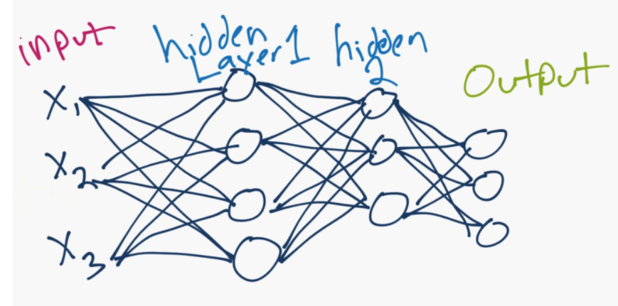
NEUral Network

Slide 5
A basic neural network consists of an input layer, which is just your data, in numerical form.
After your input layer, you will have some number of what are called "hidden" layers.
A hidden layer is just in between your input and output layers.
One hidden layer means you just have a neural network.
Two or more hidden layers results into a deep neural network!
Single hidden layer → the model is going to only learn linear relationships.
Multiple hidden layers → learn non-linear relationships between your input and output layers.

Slide 6
The idea is a single neuron is just sum of all of the inputs x weights, fed through some sort of activation function.
The activation function is meant to simulate a neuron firing or not.
A simple example would be a stepper function, where, at some point, the threshold is crossed, and the neuron fires a 1, else a 0.
Let's say that neuron is in the first hidden layer, and it's going to communicate with the next hidden layer.
So it's going to send it's 0 or a 1 signal, multiplied by the weights, to the next neuron, and this is the process for all neurons and all layers.

Slide 7
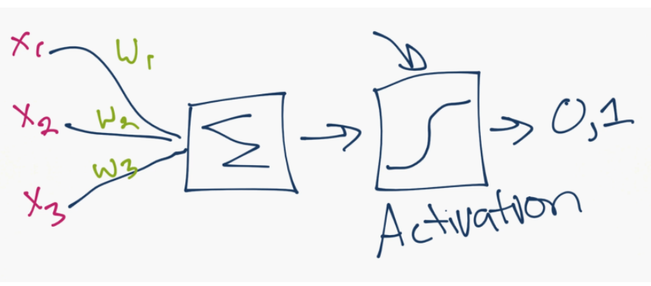
Single neuron

Slide 8
What is A TENSOR?
A multi- dimensional array

Slide 9
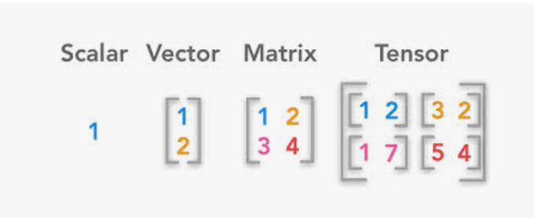

Slide 10
MNISt dataset
It's a dataset of hand-written digits, 0 through 9.
It's 28x28 images of these hand-written digits.

Slide 11
x_train data is the "features." The pixel values of the 28x28 images of these digits 0-9.
The y_train is the label (is it a 0,1,2,3,4,5,6,7,8 or a 9?)

Slide 12
Steps
1. Importing the Libraries
2. Importing the dataset
3. Splitting the dataset into Training set and Test set
4. Training model on the training set
5. Predicting the Test set results
6. Visualizing the Test set result

Slide 13
rectified linear activation function
The rectified linear activation function or ReLU for short is a piecewise linear function that will output the input directly if it is positive, otherwise, it will output zero.
It has become the default activation function for many types of neural networks because a model that uses it
is easier to train
and often achieves better performance.

